Slide 1
Using Credentials “Securely“ in the Release Pipeline
What to think about when your Release Pipeline is ready to “go public”
ANY SUPPORTING CODE AND DOCUMENTATION AT https://github.com/matthitchcock/PSConfEU17-SecuringCredentialsReleasePipeline
Matthew Hitchcock, Senior Consultant @ Microsoft, Singapore

Slide 2
TL;DR
In a TFS Release Pipeline using Release Scripts, I have found 4 ways to manage Credentials for the pipeline itself and MOF files: Enterprise Credential Manager, Azure KeyVault, TFS Secret Variables and ConvertTo-SecureString. Preferred use is in that order, based on the account sensitivity and level of risk.

Slide 3
Agenda
Introduction
Requirements and where Credentials are used
Different (feasible) options for using Credentials
Additional Mitigations
Summary

Slide 4
Introduction
This talk was ‘inspired’ by the realization that our Release Pipeline had to cross Security Boundaries … and that needed some research …
… as we thought about Production, reality dawned

Slide 5
Our Scenario Requirements
Build Runner is Team Foundation Server in Production
Build Agents use Domain Service Accounts
Build System deploys to machines in different domains with no Trusts between them
Build Agent Service Accounts should not have permissions to systems

Slide 6
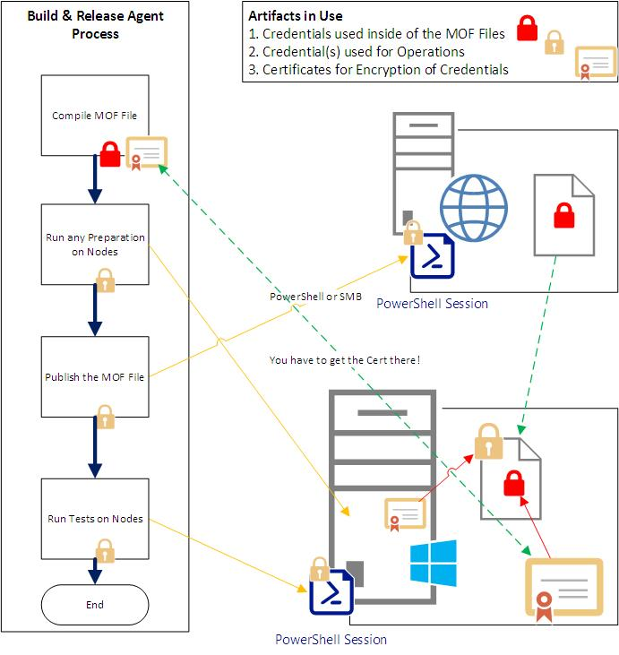
Where we use Credentials
Credentials are used:
When compiling MOF Files
When connecting to remote systems
For Encryption
We are focusing on using usernames and passwords

Slide 7
Options
An Enterprise Credential Broker
CyberArk or the Like – needs to be available in the environment
Azure KeyVault
Stores Credentials and Secrets
TFS Secret Variables
Accessible by TFS Runtime only
Get-Credential | ConvertFrom-SecureString/ConvertTo-SecureString
Hash credentials using DPAPI … limited but flexible

Slide 8
Demo
Let’s look at the options

Slide 9
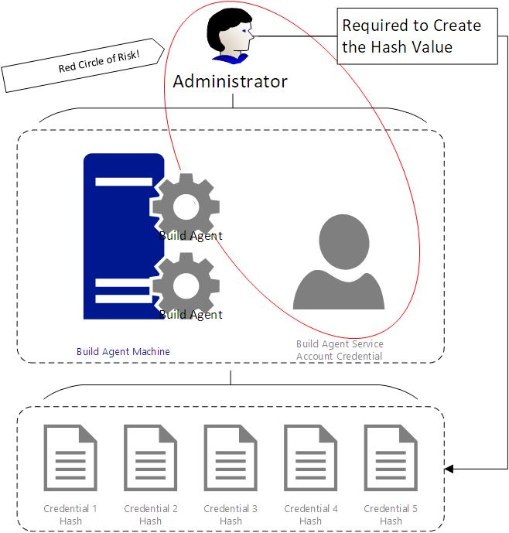
Control Credential Access
Beware the admin with the Build Agent Credentials!

Slide 10
“There is little point locking your doors if you’re leaving your ‘Windows’ open …” ~ Matthew, 9:05 (give or take a few minutes)

Slide 11
A Credential is only as useful as it’s access
Put some controls in place on Administrators who know the Build Agent Accounts ☺
Ensure the Credentials can only connect to JEA Endpoints – Configure with only the required cmdlets
Permissions should only be granted for a Release – use Just In Time Privilege Access Management (JIT PAM)

Slide 12
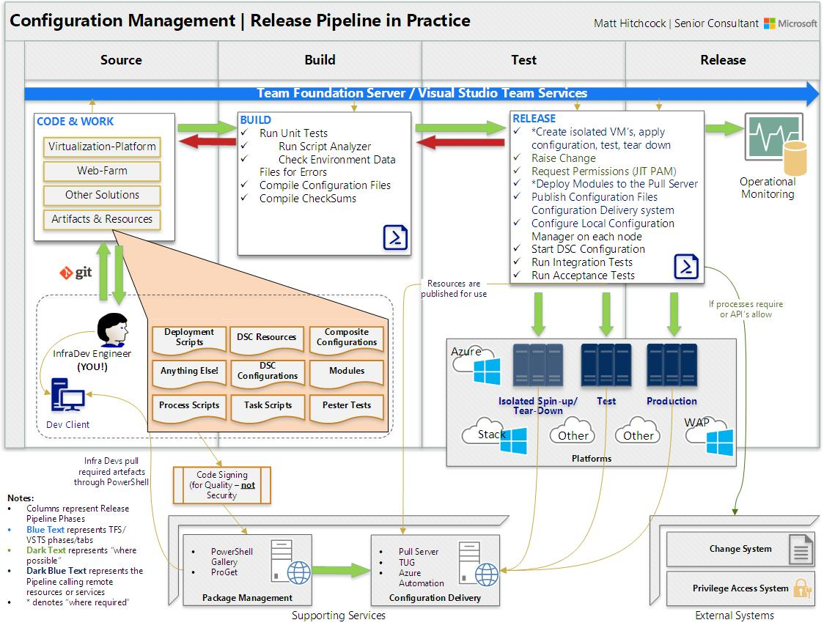

Slide 13
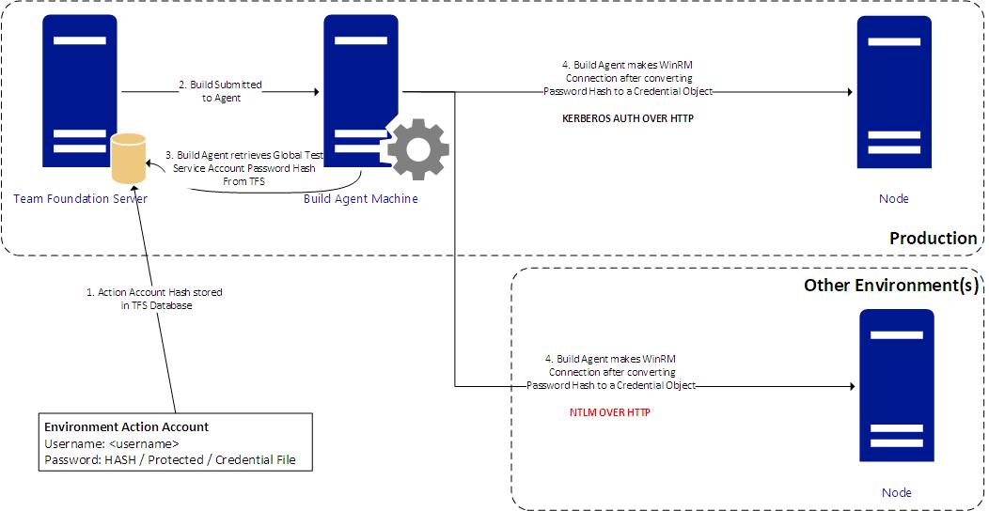
WinRM Authentication
Consider IPSEC Policies for communication from the Build System to the Nodes?

Slide 14
Keys to Success
Know your security team
Paper-based vs. Pragmatic
Know the required Controls – Risk is Relative to Environment
Don’t let security give you solutions
Limit the credential value
Permissions assigned (logon locally/interactively, JEA)
Control the Build Account owners
They can retrieve the plaintext passwords
Monitor the credential use
PowerShell Security Logging

Slide 15
Summary
Using credential ‘Securely‘ depends on more than using the credentials themselves
The very functioning of your Release Pipeline depends on appeasing your Security Team
Work with them closely, make friends, enlist them
Understand what they are trying to achieve
Ensure you are monitoring the use of the credentials and logging PowerShell activity for regular review
Certificates will have to play a part

Slide 16
Next Steps...
Now: 15 min break
Grab a coffee
Stay here to enjoy next presentation
Change track and switch to another room
Ask me questions or meet me in a breakout session room afterwards

Slide 17
Questions?

Slide 18
About_Author
Matt Hitchcock is a Senior Consultant at Microsoft. He is a former Cloud and Datacenter MVP.
Based in Singapore, Matt‘s team covers Secure Infrastructure for Asia Pacific and Japan.
Cloud & Datacenter | Cyber Security | Devices & Mobility | Identity & Security
Email: matthew.hitchcock@microsoft.com
Twitter: hitchysg_msft
GitHub: github.com/matthitchcock

